Slide 1
Applications of Programming I - Introduction to GUI
(Graphical User Interface)

Slide 2
Objectives
At the end of this lecture, you will learn about . . .
Writing GUI (Graphical User Interface) Applications in Python
Writing GUI Applications in Python using Tkinter

Slide 3
Writing GUI Applications in Python
Toolkits for writing GUI Applications in Python
Tkinter
easiest to start with
standard Python GUI package
Jpython
Python platform for Java that is providing Python scripts seamless access o Java class Libraries for the local machine
wxPython
an open-source, cross-platform GUI toolkit written in C++
an alternative to Tkinter, bundled with Python

Slide 4
Writing GUI Applications in Python using Tkinter
Steps
1. Import Tkinter
2. Create the main window
3. Add the widgets (needed for the application)
(need to organize the widgets using a layout manager)
4. Add the main event loop (for handling user events)

Slide 5
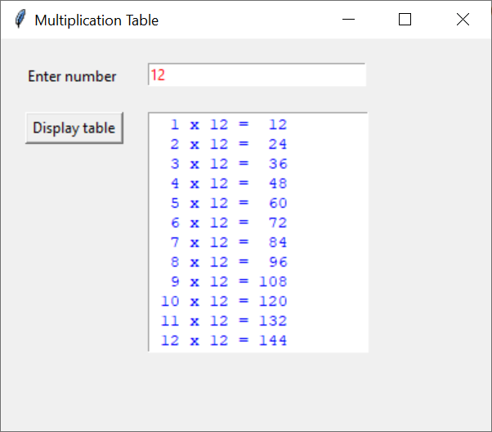
Sample GUI Application – Multiplication Table

Slide 6
Sample GUI Application – Multiplication Table
# 1. Import tkinter
from tkinter import *
# 2. Create main window
window = Tk()
window.title("Multiplication Table")
window.geometry('400x300')
# 3. Add widgets e.g. Label, Entry, Button, Text
lblNumber = Label(window, text="Enter number", width=12)
entNumber = Entry(window, fg='red', width=24)
btnDisplay = Button(window, text="Display table", width=12)
txtTable = Text(window, fg='blue', width=18, height=12)
# Organize (lay out) the widgets using place() manager
lblNumber.place(x=20, y=20) # column 1, row 1
btnDisplay.place(x=20, y=60) # column 1, row 2
entNumber.place(x=120, y=20) # column 2, row 1
txtTable.place(x=120, y=60) # column 2, row 2
# 4. Add main event loop (to handle user events)
window.mainloop()

Slide 7
Sample GUI Application – Multiplication Table
Need to define the function(s) to be used in the application
Need to add the command option for the button to call the function when the button is clicked as shown below:
# Define the function(s) to be used in the application
def display_table():
n = int(entNumber.get())
txtTable.delete("1.0", END) # clear the content
for i in range(1,13):
row = "{:3} x {:2} = {:3}\n".format(i, n, i * n)
txtTable.insert(END, row) # insert new content
from tkinter import *
. . .
. . .
btnDisplay = Button(. . . , command=display_table)
. . .
. . .

Slide 8
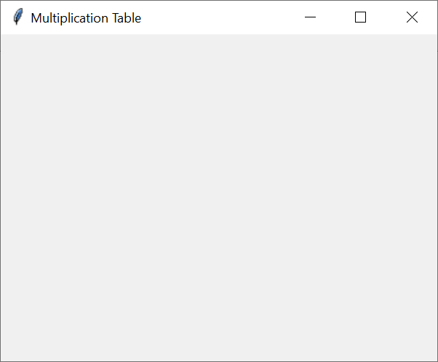
Creating the main window
To create the main window,
window = Tk()
To set the title of the window,
window.title("Multiplication Table")
To set the size of the window,
window.geometry('400x300’) # in pixels

Slide 9
Adding widgets for the application
5 Basic Widgets
Widget | Description
Label | for displaying text on the screen
Button | for perform an action when clicked
Entry | for entering or displaying a line of text
Text | for entering or displaying multiple lines of text
Frame | for grouping related widgets
For more widgets (e.g. Radionbutton, Checkbuton, Listbox), go to:
https://www.tutorialspoint.com/python/python_gui_programming.htm

Slide 10
Creating the widgets – Format
Widget | Format
Label | lblX = Label(master, option=value, ...)
Button | btnX = Button(master, option=value, ...)
Entry | entX = Entry(master, option=value, ...)
Text | txtX = Text(master, option=value, ...)
Frame | frmX = Frame(master, option=value, ...)

Slide 11
Setting the attributes
Common Attributes
Attribute | Format | Example
text | text='...' | text='Number'
font | font=(type, size) | font=('Arial', 12)
width | width=size | width=20
height | height=size | height=20
fg | fg=color | fg='blue'
bg | bg=color | bg='light yellow'
command | command=fn | command=display_table

Slide 12
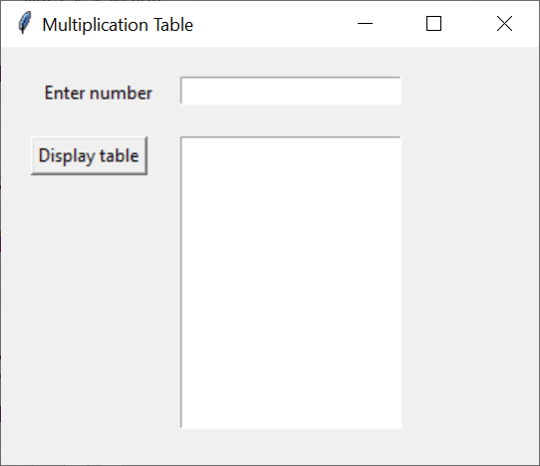
Adding widgets – Example
lblNumber = Label(window, text="Enter number", width=12)
entNumber = Entry(window, fg='red', width=24)
btnDisplay = Button(window, text="Display table")
txtTable = Text(window, width=18, height=12)
''' lay out the widgets (using place manager)
lblNumber.place(x=20, y=20)
entNumber.place(x=120, y=20)
btnDisplay.place(x=20, y=60)
txtTable.place(x=120, y=60)
'''

Slide 13
Functions in Entry widget
Function | Description
get() | returns the entry's current text as a string.
insert() | inserts a string before the character at the given index.
delete() | deletes characters from the widget, starting with the one at index first, up to but not including the character at position last. If the second argument is omitted, only the single character at position first is deleted.

Slide 14
Functions in Text widget
Function | Description
get() | returns a specific character or a range of text.
insert() | inserts strings at the specified index location.
delete() | deletes a specific character or a range of text.
index() | returns the absolute value of an index based on the given index.

Slide 15
Layout Managers
pack manager
- organizes the geometry of widgets in blocks one by one
e.g. lblName.pack()
grid manager
- organizes widgets in a tabular structure (row, column)
e.g. lblName.place(row=0, column=0)
entName.place(row=0, column=1)
place manager
- organizes the widgets in a specific positions (x,y)
e.g. lblName.place(x=20,y=20) # in pixels
entName.place(x=100,y=20) # in pixels

Slide 16
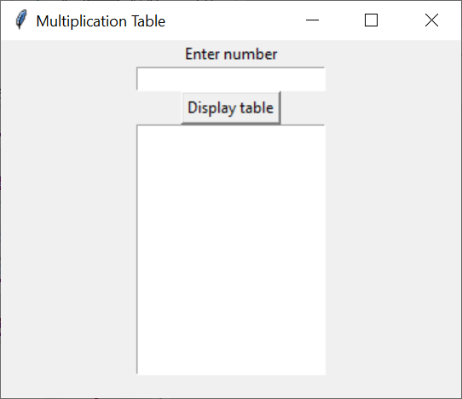
Organizing the widgets using pack manager
# Organize (lay out) the widgets one by one
lblNumber.pack()
entNumber.pack()
btnDisplay.pack()
txtTable.pack()

Slide 17
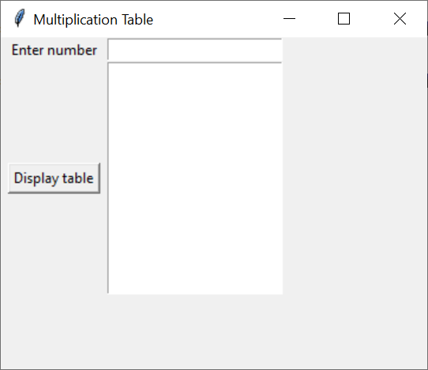
Organizing the widgets using grid manager
# Organize (lay out) the widgets in rows and columns
lblNumber.grid(row=0, column=0)
entNumber.grid(row=0, column=1)
btnDisplay.grid(row=1, column=0)
txtTable.grid(row=1, column=1)

Slide 18

Organizing the widgets using place manager
# Organize (lay out) the widgets at specific positions
lblNumber.place(x=20, y=20)
entNumber.place(x=120, y=20)
btnDisplay.place(x=20, y=60)
txtTable.place(x=120, y=60)

Slide 19
Activity 1 – GUI Multiplication Table
Write a GUI Multiplication Table Application with the user interface shown below.

Slide 20
Activity 1 – GUI Multiplication Table
Solution
Refer to Multiplication_Table.py

Slide 21
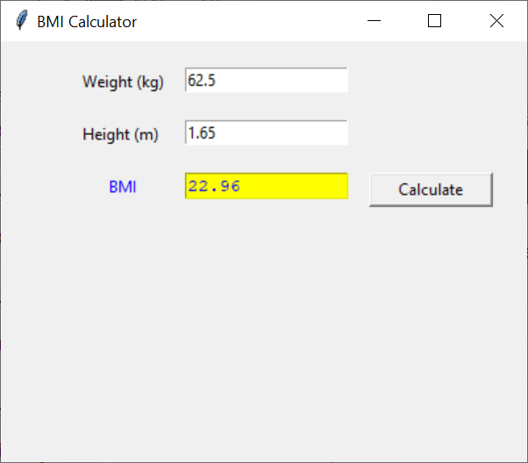
Activity 2 – GUI BMI Calculator
Write a GUI BMI Calculator Application with the user interface shown below.
Formula to calculate bmi:
bmi = weight / (height * height)

Slide 22
Activity 2 – GUI BMI Calculator
Solution
Refer to BMI_Calculator.py

Slide 23
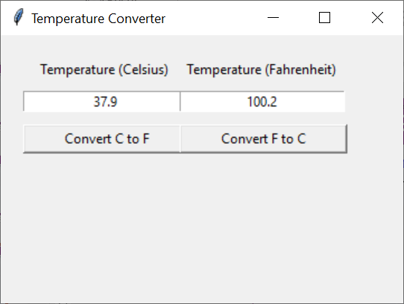
Activity 3– GUI Temperature Converter
Write a GUI Temperature Converter Application with the user interface shown below.
Formula to convert from c to f:
f = ( c * 9 / 5) + 32
Formula to convert from f to c:
c = (f – 32 ) * 5 / 9
c : temperature in celsius
f : temperature in fahreheit

Slide 24
Activity 3– GUI Temperature Converter
Solution
Refer to Temperature_Converter.py

Slide 25
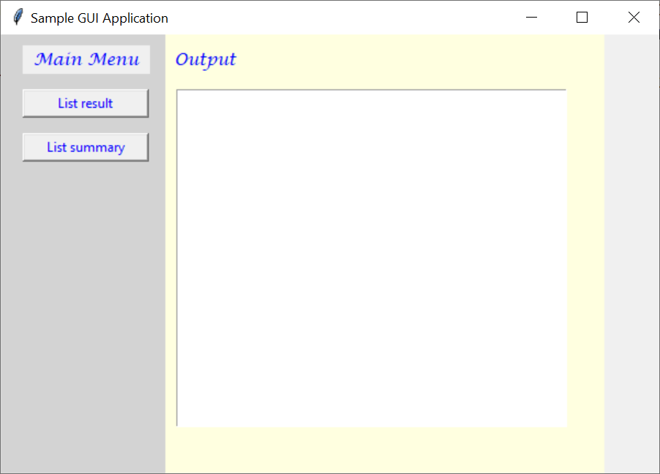
Creating multiple windows using Frame widget
The Frame widget can be used to create multiple windows in a GUI application as shown below.

Slide 26
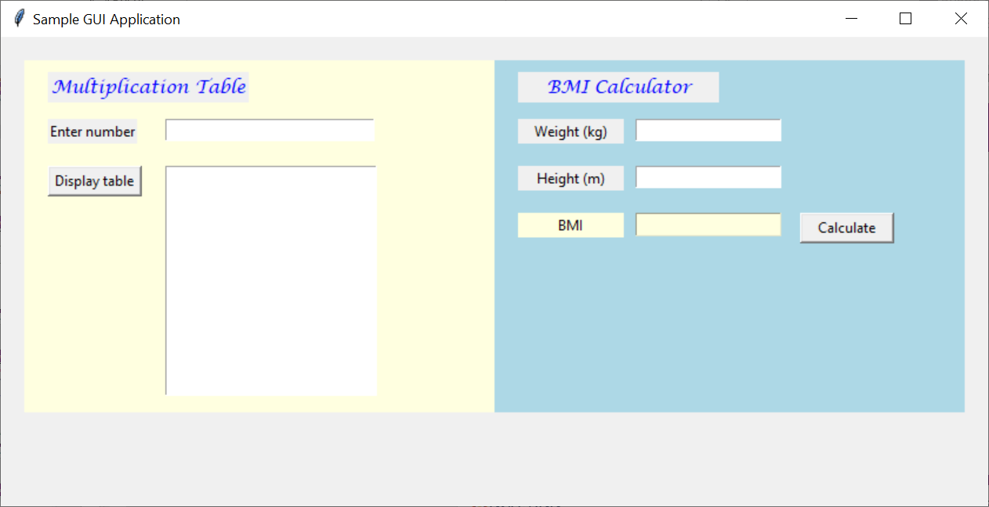
Creating multiple windows using Frame widget
Example 2

Slide 27
Creating multiple windows – Example
# 1. Import tkinter
from tkinter import *
'''-------------------- Function(s) ----------------------'‘’
. . .
. . .
. . .
''' ------------------------------------------------------ '''
# 2. Create the main window
window = Tk()
window.title('Sample GUI Application')
window.geometry(‘800x400’)

Slide 28
Creating multiple windows – Example
# Create Frame 1
f1 = Frame(window, bg='light yellow', width=400, height=300)
# Add (and organize) widgets in Frame 1
lblNumber = Label(f1, text="Enter number", width=10)
. . .
. . .
# Create Frame 2
f2 = Frame(window, bg='light blue', width=400, height=300)
# Add (and organize) widgets in Frame 2
lblWeight = Label(f2, text="Weight (kg)", width=12)
. . .
. . .
# Organize the frames in the main window
f1.place(x=20, y=20)
f2.place(x=420, y=20)
# 4. Add main event loop (to handle user events)
window.mainloop()

Slide 29
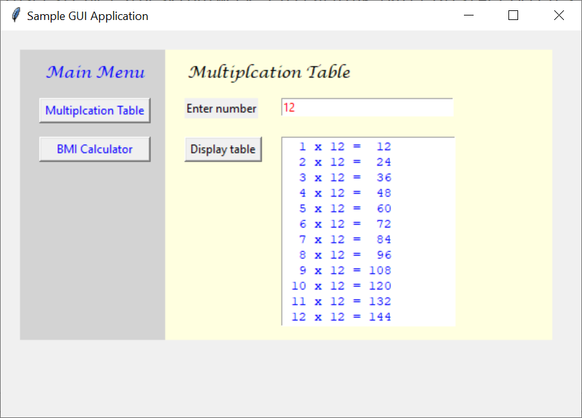
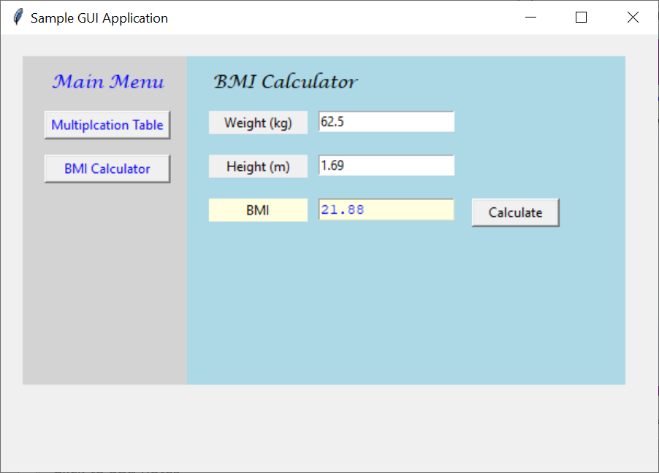
Activity 4 – Optional
Integrate the Multiplication Table and BMI Calculator applications using frames as shown below:

Slide 30
Activity 4 – Optional
Solution
Refer to Sampl_GUI_Application.py

Slide 31
Summary
Writing Python GUI Applications using Tkinter – Steps
1. Import Tkinter
2. Create the main window
3. Add the widgets (for the application)
(need to organize the widgets using a layout manager)
4. Add the main event loop (for handling user events)

Slide 32
Reading Reference
Python GUI Programming (w3schools)
-> https://www.w3schools.in/python-tutorial/gui-programming/
Python GUI Programming (tutorialspoint)
-> https://www.tutorialspoint.com/python/python_gui_programming.htm

